Slide 1
Why Python? - The Pros and Cons.

Slide 2
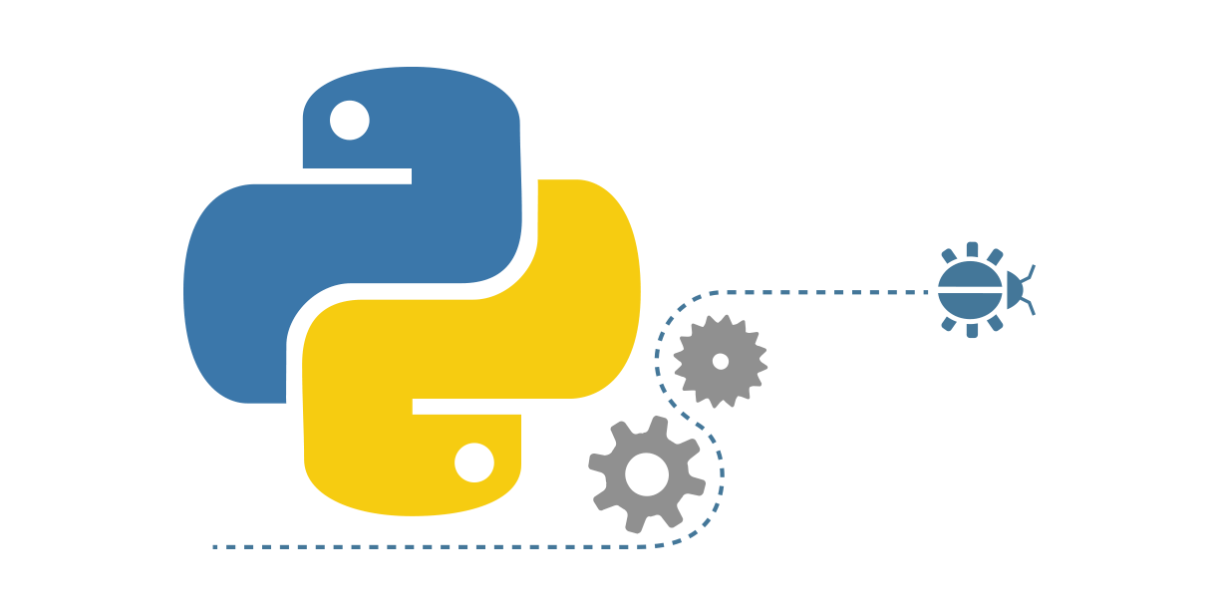
Agenda
Python: Brief Intro
Advantages and Applications
Python: Limitations
Python in the Industry
Bottomline: Benefits of Learning Python
Notes:
To understand this, let’s take a scenario.

Slide 3
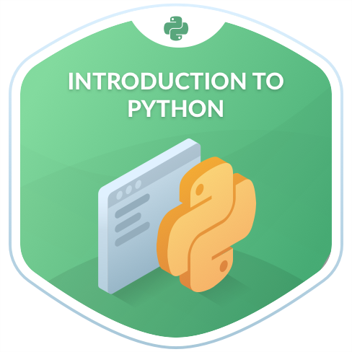
Python - Brief Intro
Python is a high level, interpreted and general purpose dynamic programming language.
Python has a design philosophy that emphasizes code readability, notably using significant whitespace.
It provides constructs that enable clear programming on both small and large scales.

Slide 4
Python - Brief Intro
It has fewer steps when compared to Java and C when writing a common code.
It is used in many organizations as it supports multiple programming paradigms
Programming paradigms are a way to classify programming languages based on their features. Languages can be classified into multiple paradigms.
It also performs automatic memory management.

Slide 5
Advantages and Applications

Slide 6
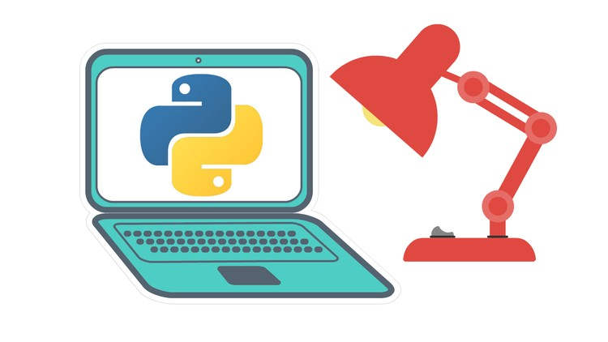
Python - Advantages
Python is easy to learn for even a novice developer. Its code is easy to read and you can do a lot of things just by looking at it.
Also, you can execute a lot of complex functionalities with ease, thanks to the standard library.
Supports multiple systems and platforms.
Object Oriented Programming-driven.
Dynamically typed language(No need to mention data type based on value assigned, it takes data type)

Slide 7
Python - Advantages
The Raspberry Pi - which is a mini computer and DIY lover's dream - relies on Python as it's main programming language too.
Developers can now build cameras, radios and games with ease. So, learning Python could open new avenues for you to create some out-of-the box gadgets.
Gives rise to quick development by using less code. Even a small team can handle Python effectively.

Slide 8
Python - Advantages
Python has a plethora of frameworks that make web programming very flexible. Django is the most famous Python framework for web development.
Flask is another micro web framework written in Python and based on the Werkzeug toolkit and Jinja2 template engine.
Applications that use the Flask framework include Pinterest, LinkedIn, and the community web page for Flask itself.

Slide 9
Python - Advantages
Presence of third-party modules
Extensive support libraries(NumPy for numerical calculations, Pandas for data analytics etc.)
Offers a built in testing framework to set debugging time and enable fastest workflows.

Slide 10
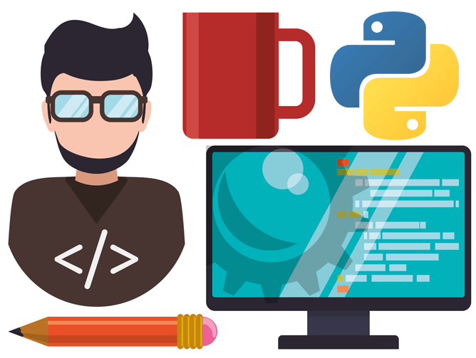
Python in the Industry
Of course, the vast majority of IT giants, including Google, Dropbox, Spotify and Instagram are using it.
However, the trend has spread far and wide into industries such as science, gaming and graphics, meaning companies such as NASA, Electronic Arts and Disney have made it a central part of their systems too.

Slide 11

Python in the Industry
On the whole, python is part of the winning formula for productivity, software quality, and maintainability at many companies and institutions around the world.
Organizations using Python :
Google(Components of Google spider and Search Engine)
Yahoo(Maps)
YouTube
Mozilla
Dropbox
Microsoft
Cisco
Spotify
Quora and many more..!

Slide 12
Python in the Industry
However, here are some of the most common applications of Python in the Field:
GUI based desktop applications(Games, Scientific Applications)
Web frameworks and applications
Enterprise and Business applications
Operating Systems
Language Development
Prototyping

Slide 13
Python: Limitations

Slide 14
Python: Limitations
Weak in Mobile Computing
Python has made its presence on many desktop and server platforms, but it is seen as a weak language for mobile computing.
Gets Slow in Speed
Python executes with the help of an interpreter instead of the compiler, which causes it to slow down because compilation and execution.
Underdeveloped Database Access Layers
As compared to the popular technologies like JDBC and ODBC, the Python’s database access layer is found to be bit underdeveloped and primitive.

Slide 15
Benefits of Learning Python

Slide 16
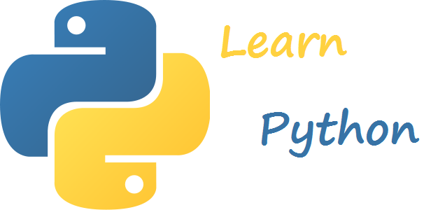
Benefits of Learning Python
Python can be used to develop prototypes, and quickly because it is so easy to work with and read.
Most automation, data mining, and big data platforms rely on Python. This is because it is the ideal language to work with for general purpose tasks.

Slide 17
Benefits of Learning Python
Python allows for a more productive coding environment than massive languages like C# and Java. Experienced coders tend to stay more organized and productive when working with Python, as well.
An ideal candidate for use among multi-programmer and large development teams.

Slide 18
Benefits of Learning Python
Python powers Django, a complete and open source web application framework. Frameworks - like Ruby on Rails - can be used to simplify the development process.

Slide 19
Benefits of Learning Python
It has a massive support base thanks to the fact that it is open source and community developed.
Millions of like-minded developers work with the language on a daily basis and continue to improve core functionality.

Slide 20
END

